Slide 1
SLD 2600
Week 5

Slide 2
Strength Finder

Slide 3

Diversity
We all think of the typical ways of thinking about diversity: age, race, socio-economic status, etc.
But what about diversity in the ways we think?
How are the ways we process information, learn, pay attention, and decide, as well as the habits of mind which contribute to our success or failure in work, school and other ventures, diverse?
The three instruments which I have used over the last 25 years to measure these sort of diversity are:
  Myers-Briggs Type Indicator
  Enneagram
  StrengthsFinder
  (I also like Howard Gardner’s Theory of Multiple Intelligences)

Slide 4
Strengths Finder
Created by Donald Clifton and team at Gallup in 1998
Basis in Positive Psychology
  Much of education is based on a Deficit model
  People have much more potential for growth when they invest the energy in developing their strengths instead of correcting their deficiencies.
It has been completed by over 4 million people worldwide
34 total themes were identified; each theme is a group of similar talents
You received your 5 dominant or Signature themes

Slide 5

Strength = Talent + Knowledge + Skill
Strength – Consistent near perfect performance in an activity
Talent – naturally recurring thought, feeling or behavior, potential
Knowledge – Facts and lessons learned, Information and understanding
Skill – Steps of an activity
Excellent comes from maximizing strengths, not by fixing weaknesses

Slide 6
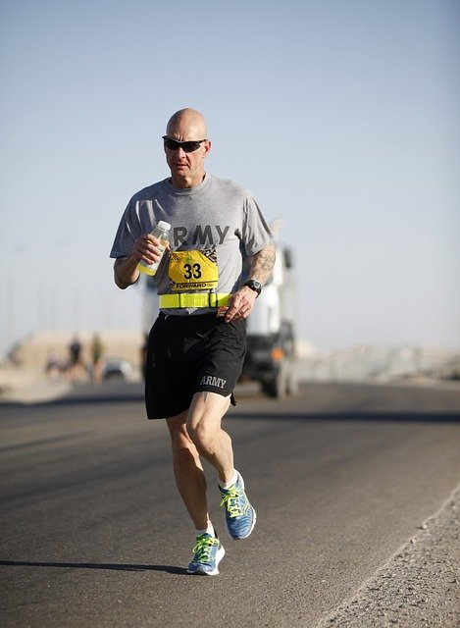
Talent
Behavior that makes you effective
Thought patterns that make you efficient
Beliefs that empower you to succeed
Attitudes that sustain your efforts toward achievement and excellence
Motivations that propel you to take an action and maintain the energy needed to achieve

Slide 7
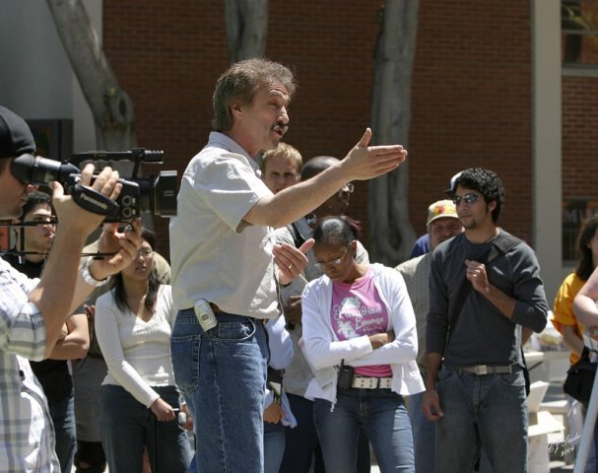
Strengths
Each person’s talents are unique and enduring.
Each person’s greatest potential for growth and success is in the areas of their strength.
When you’re operating from your “strength”—you’re more likely to be Effective, Satisfied, and Engaged.
Organizations are best served when individuals are provided with opportunities that leverage their strengths.
  Individuals are able to maximize their potential
  Greatest level of satisfaction
  Innovation happens naturally
  Strong commitment and high level of energy

Slide 8

Strength = Talent × Investment
Investment in growing your knowledge and skills
Developing your natural talents—easier, more satisfying, and yields higher returns
So…how to manage weaknesses
  Develop practices to support your weaknesses
  Partner with someone who has other strengths
Know your blind spots…the Shadow Side of your Strength

Slide 9
5 Clues to Talent
Yearning To what kinds of activities are you naturally drawn? |  | Rapid Learning What kinds of activities do you seem to pick up on quickly?
 | Flow In what activities did the “steps” just come to you automatically?
Glimpses of Excellence During what activities have you had moments of subconscious excellence, when you thought, “How did I do that?” |  | Satisfaction What activities give you a kick, either while doing them or immediately after finishing them, so much so you want to do it again?

Slide 10
Demonstrating Your Strengths
We are most successful and engaged when we follow who we naturally are to fulfill the requirements of our roles. Use this exercise to think about other areas of your life and other roles you play or challenges you have coming up.
Signature Strength | What this Strength Allows me to do | When/Where I Recently Used this Strength

Slide 11
The Shadow Side: Misperceptions and Misuse
Your Signature Strength | How it can be Perceived Negatively | The Shadow Side: The Weakness of Your Strength

Slide 12
Challenges Affirming our Strengths
Being blind to our own greatest talents or to the talents of others
Jealousy driven conflict because others are threatened by our talent
Being in roles that don’t suit our talent
Fear of pride or arrogance diminishes what we have to offer
Lack of vision about how our talents helps us to achieve our goals

Slide 13
What about weaknesses?
Consider reframing or redefining weakness
Distinguish what’s getting in your way, or in others’ way
Actions to take to address “Weakness”
  Be open and transparent; ask for feedback
  Get the RIGHT training
  Leverage other talents
  Form complementary partnerships
  Adjust or change your role

Slide 14
Leadership Themes
Executing | Influencing | Relationship Building | Strategic Thinking
Achiever | Activator | Adaptability | Analytical
Arranger | Command | Developer | Context
Belief | Communication | Connectedness | Futuristic
Consistency | Competition | Empathy | Ideation
Deliberative | Maximizer | Harmony | Input
Discipline | Self-assurance | Includer | Intellection
Focus | Significance | Individualization | Learner
Responsibility | Woo | Positivity | Strategic
Restorative |  | Relator

Slide 15
Leadership Domains
Executing Leadership style: Leaders with dominant strength in the Executing domain know how to make things happen. When you need someone to implement a solution, these are the people who will work tirelessly to get it done. Leaders with a strength to execute have the ability to “catch” an idea and make it a reality.
Influencing Leadership style: Those who lead by Influencing help their team reach a much broader audience. People with strength in this domain are always selling the team’s ideas inside and outside the organization. When you need someone to take charge, speak up, and make sure your group is heard, look to someone with the strength to influence.
Relationship Leadership style: Those who lead through Relationship Building are the essential glue that holds a team together. Without these strengths on a team, in many cases, the group is simply a composite of individuals. In contrast, leaders with exceptional Relationship Building strength have the unique ability to create groups and organizations that are much greater than the sum of their parts.
Strategic Thinking Leadership style: Leaders with great Strategic Thinking strengths are the ones who keep us all focused on what could be. They are constantly absorbing and analyzing information and helping the team make better decisions. People with strength in this domain continually stretch our thinking for the future.

Slide 16


Complementary Partnerships
Complementary partnerships are formed when two or more people come together to achieve something greater than what they could have achieved apart. Some of the best partnerships are formed when we consciously think about our talents and the talents that may complement our own.
Think about the strengths you might want or need in a collaborative partner. Write your strengths on the figure to the left. Then, identify five strengths that you would most like to have in a collaborative partner. Place these strengths on the figure on the right.

Slide 17
To Consider: Strengths Dialogue
What do you enjoy most about your role in this organization?
What performance goal are you focused on right now?
Which of your top strengths could you leverage toward this performance goal?
What can I do to be a better partner to you?

Slide 18
Conclusion
Too often, groups, teams, or organizations reify, or self-replicate, the individuals, traits, and structures of the organizations to which they belong. This duplicates existing strengths and dispositions of current members. While this makes things simpler and more predictable, research says that it does not make for the best decision-making.
A diversity of types, strengths, or temperaments, on the other hand, is messy. It generally requires more time and causes more conflict. But it does tend to lead to better, more adaptive, more fully realized, and simply “smarter” outcomes.

Slide 19
Upcoming

Slide 20
Next time…
First-year students: Study skills
Second-year students: Graduate school

Slide 21
Reminders
Next class meeting:
  First-year students: September 21
  Second-year students: September 28
Assignment 2 is due next Monday

